Slide 1
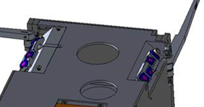
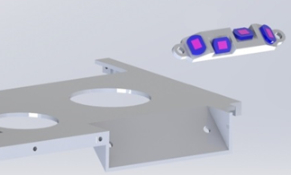
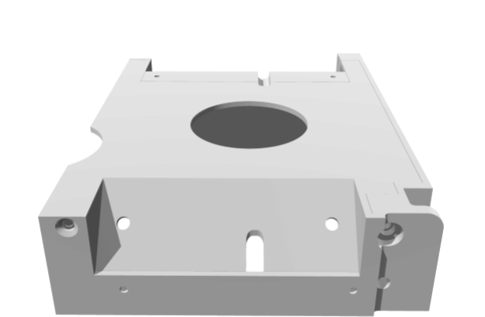
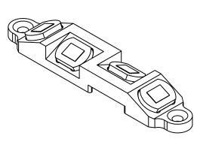
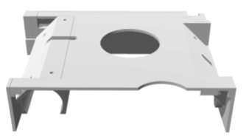
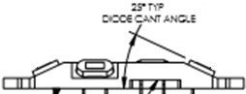
Sun sensor assembly is mounted on a 45° face
45°
Each Si Photodiode on the assembly is also mounted at a 25° angle (from horizontal)
45°

Slide 2
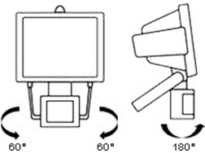
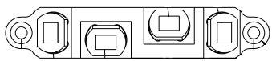
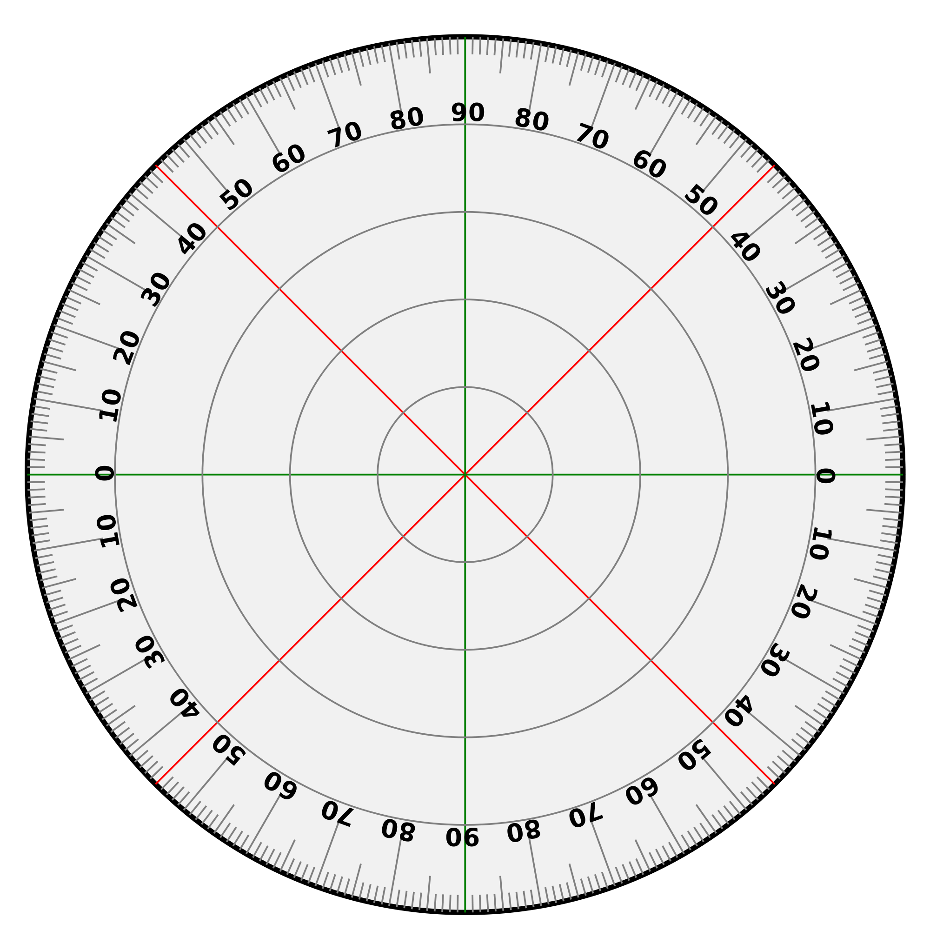
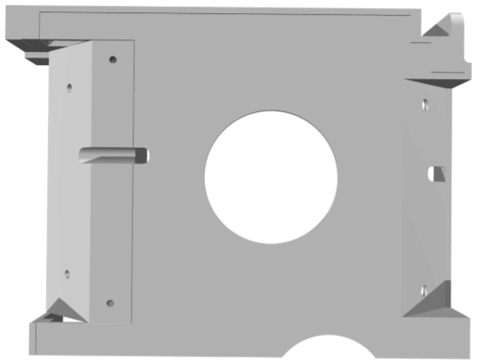
0° Azimuthal
Note: Light intensity at the sensor was set to be
nominally identical to the solar light intensity at 1 A.U. as measured by an optical power meter.
Alignment error
Top View
180°
4
3
1
2
0°
135°
45°
2
4
1
90°
3
90° Azimuthal
Increase azimuthal
angle in 10° increments
from 0° → 180°
90°
Sensor 4
Sensor 3
Sensor 1
Sensor 2
225°
135°
180°

Slide 3
0° Azimuthal
Top View
180°
4
3
1
2
0°
135°
45°
90°
2
4
1
3
90° Azimuthal
Increase azimuthal
angle in 10° increments
from 0° → 180°
90°
Sensor 4
Sensor 3
Sensor 1
Sensor 2
225°
135°
180°

Slide 4
0° Azimuthal
Top View
180°
4
3
1
2
0°
135°
45°
2
4
1
90°
3
90° Azimuthal
Increase azimuthal angle in 10° increments from 0° → 180°
90°
Sensor 4
Sensor 3
Sensor 1
Sensor 2
225°
135°
180°

Slide 5
Back-Up Slides

Slide 6
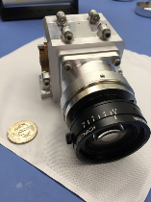
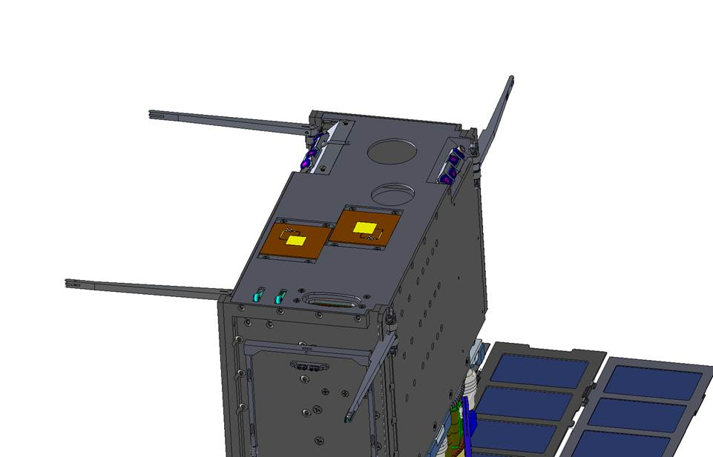
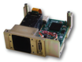
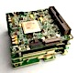
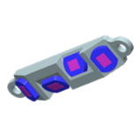
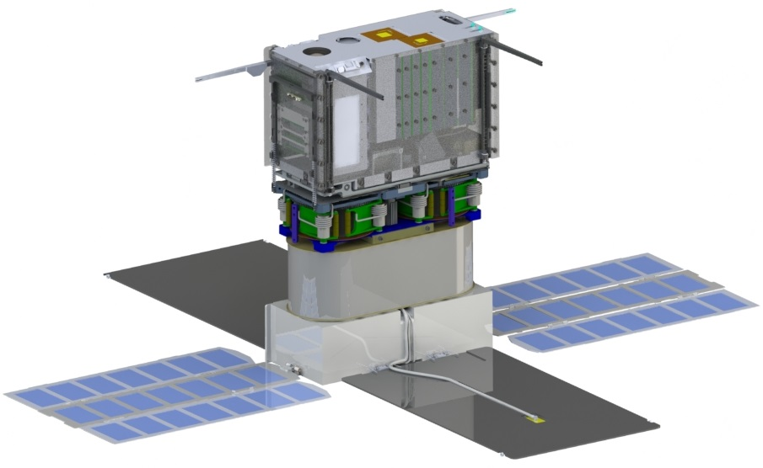
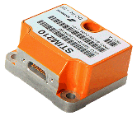
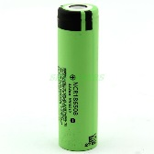
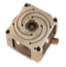
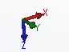
Drawings
NEA Imager
Star Tracker/
Drive Control Electronics*
(BCT)
LGAs
Iris 2.1 Transponder and Electronics
Sun Sensors*
(BCT)
IMU (Sensonor)
6x 18650 Lithium Batteries
(Panasonic)
4X RWA 15 mNms
(BCT)

Slide 7
Drawings

Slide 8
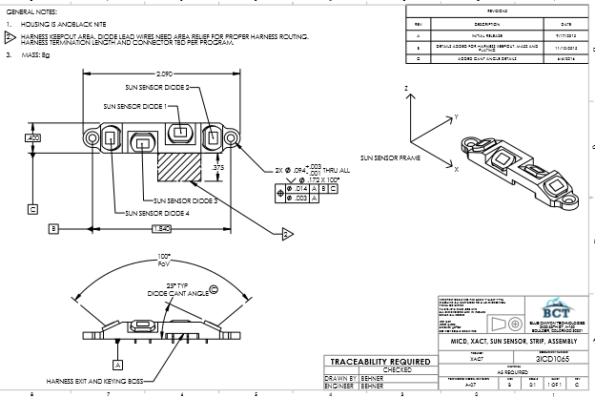
Drawings

Slide 9
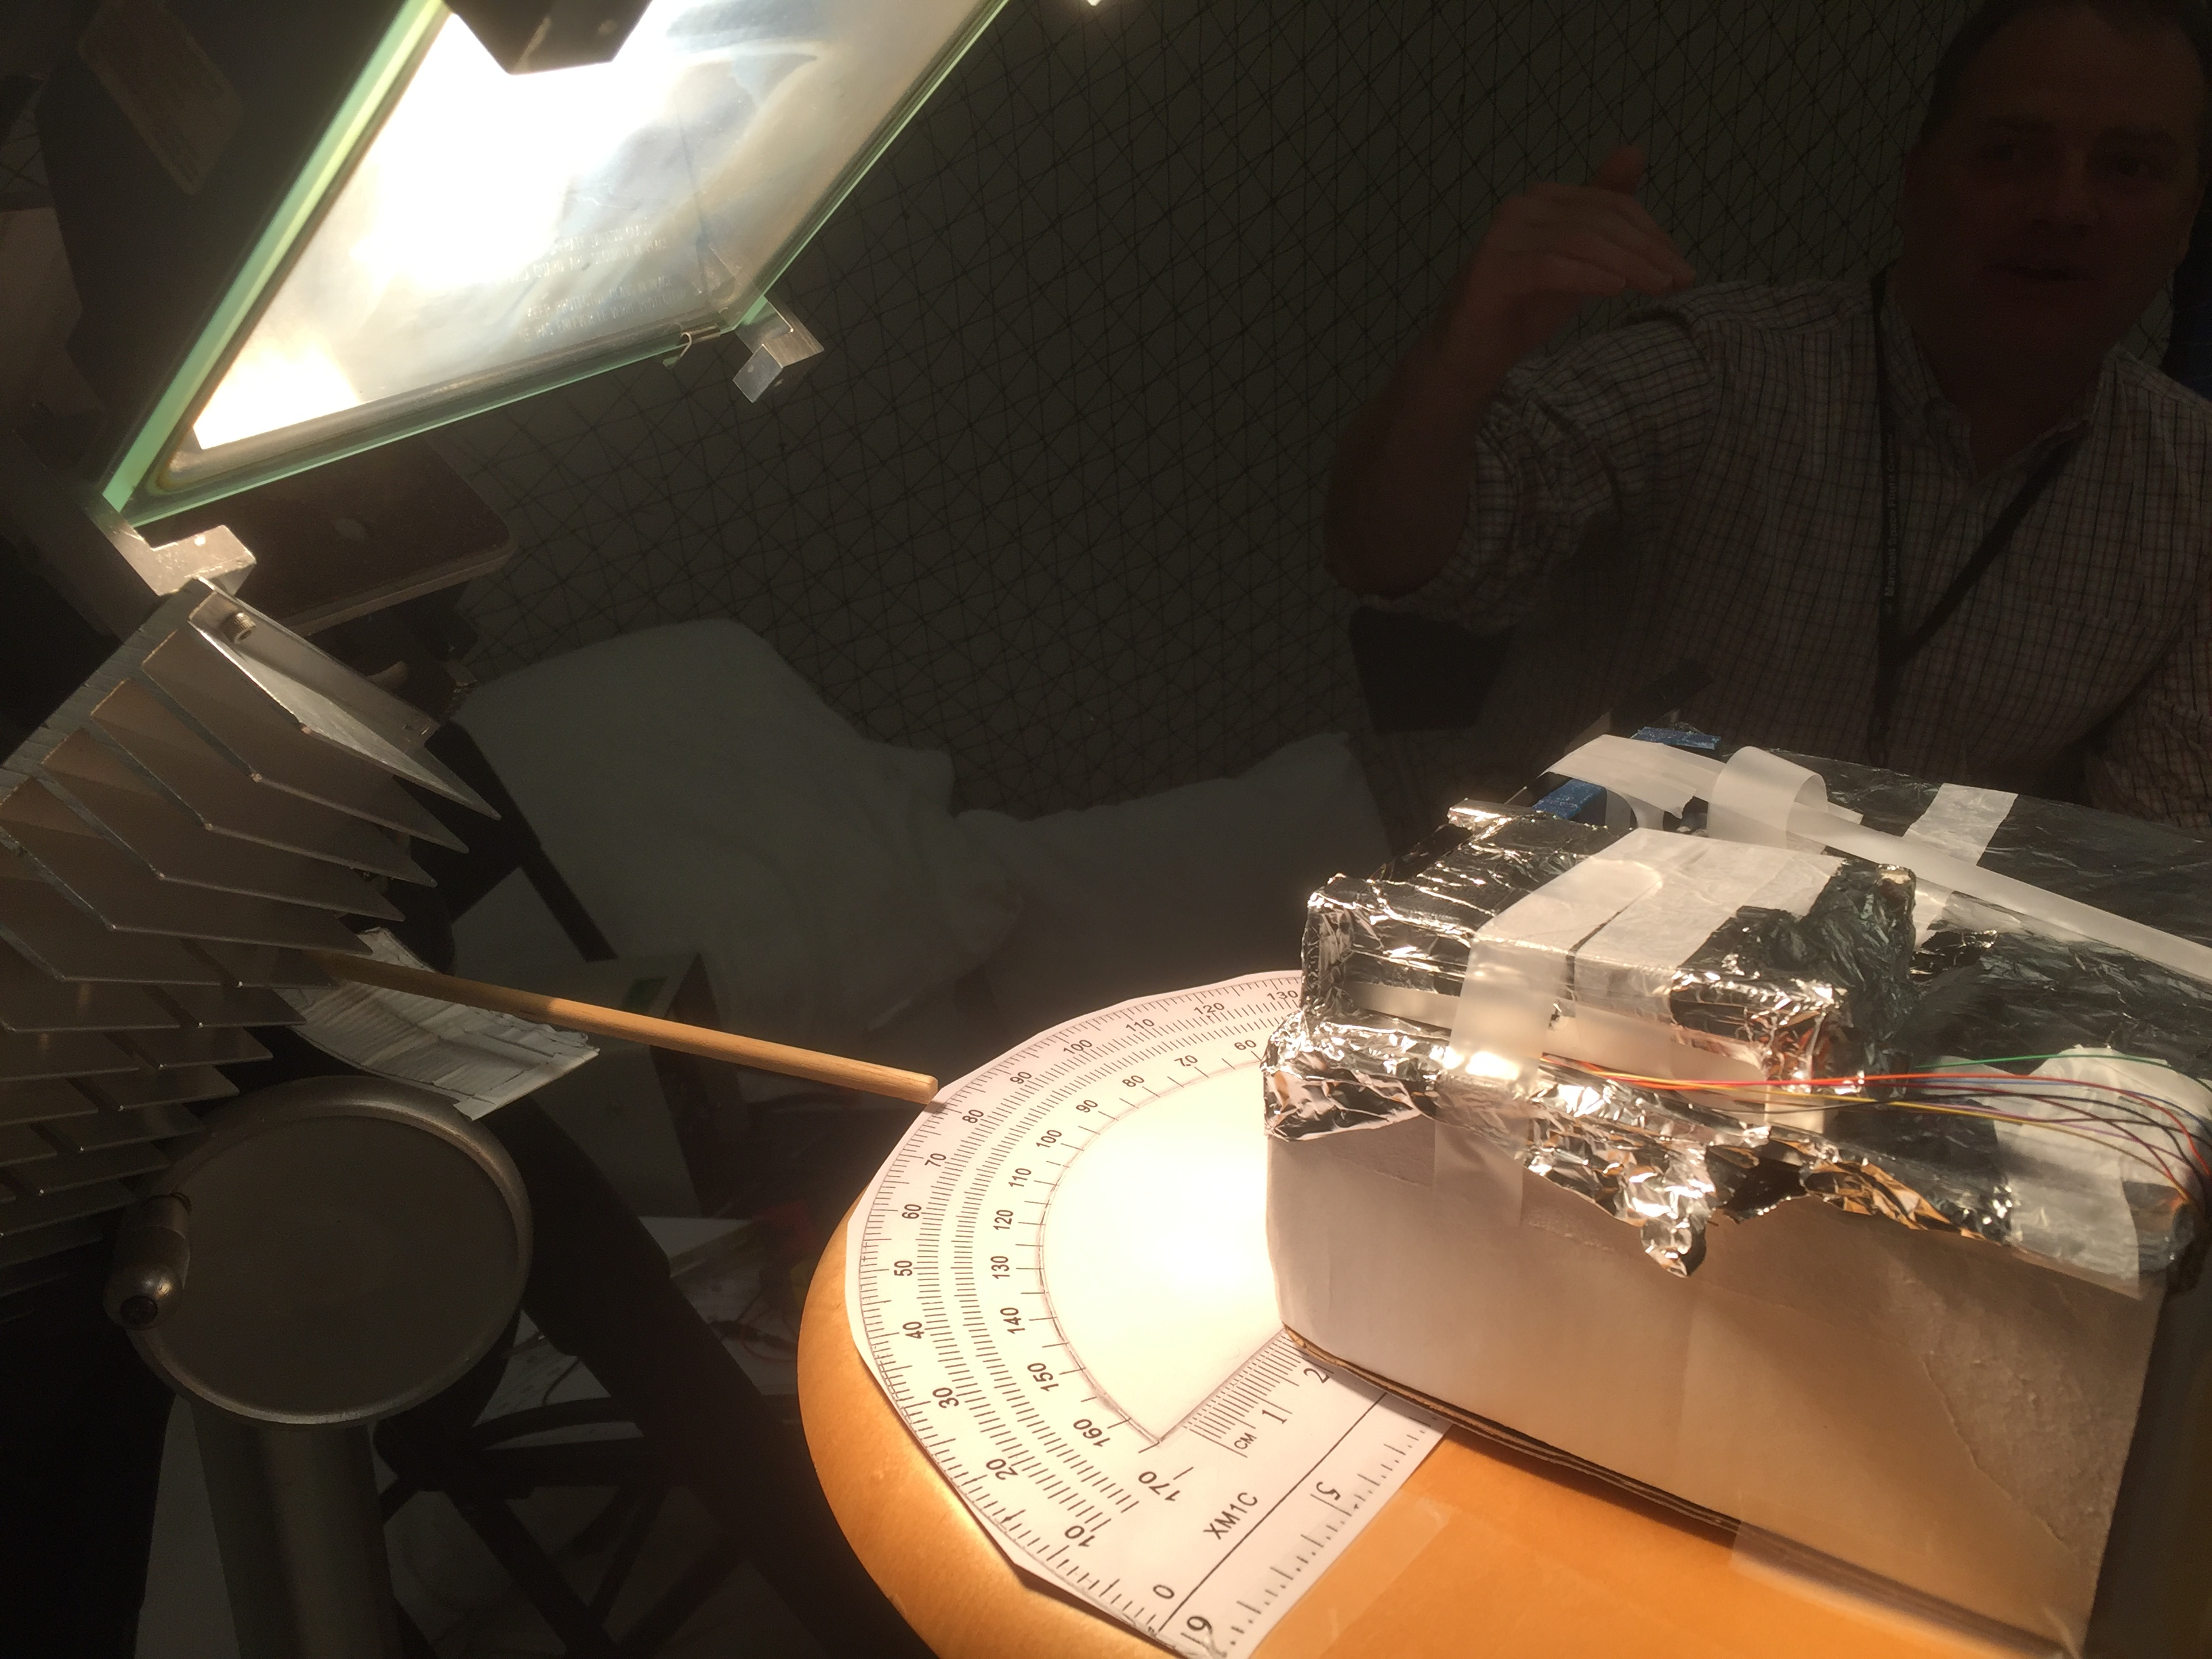
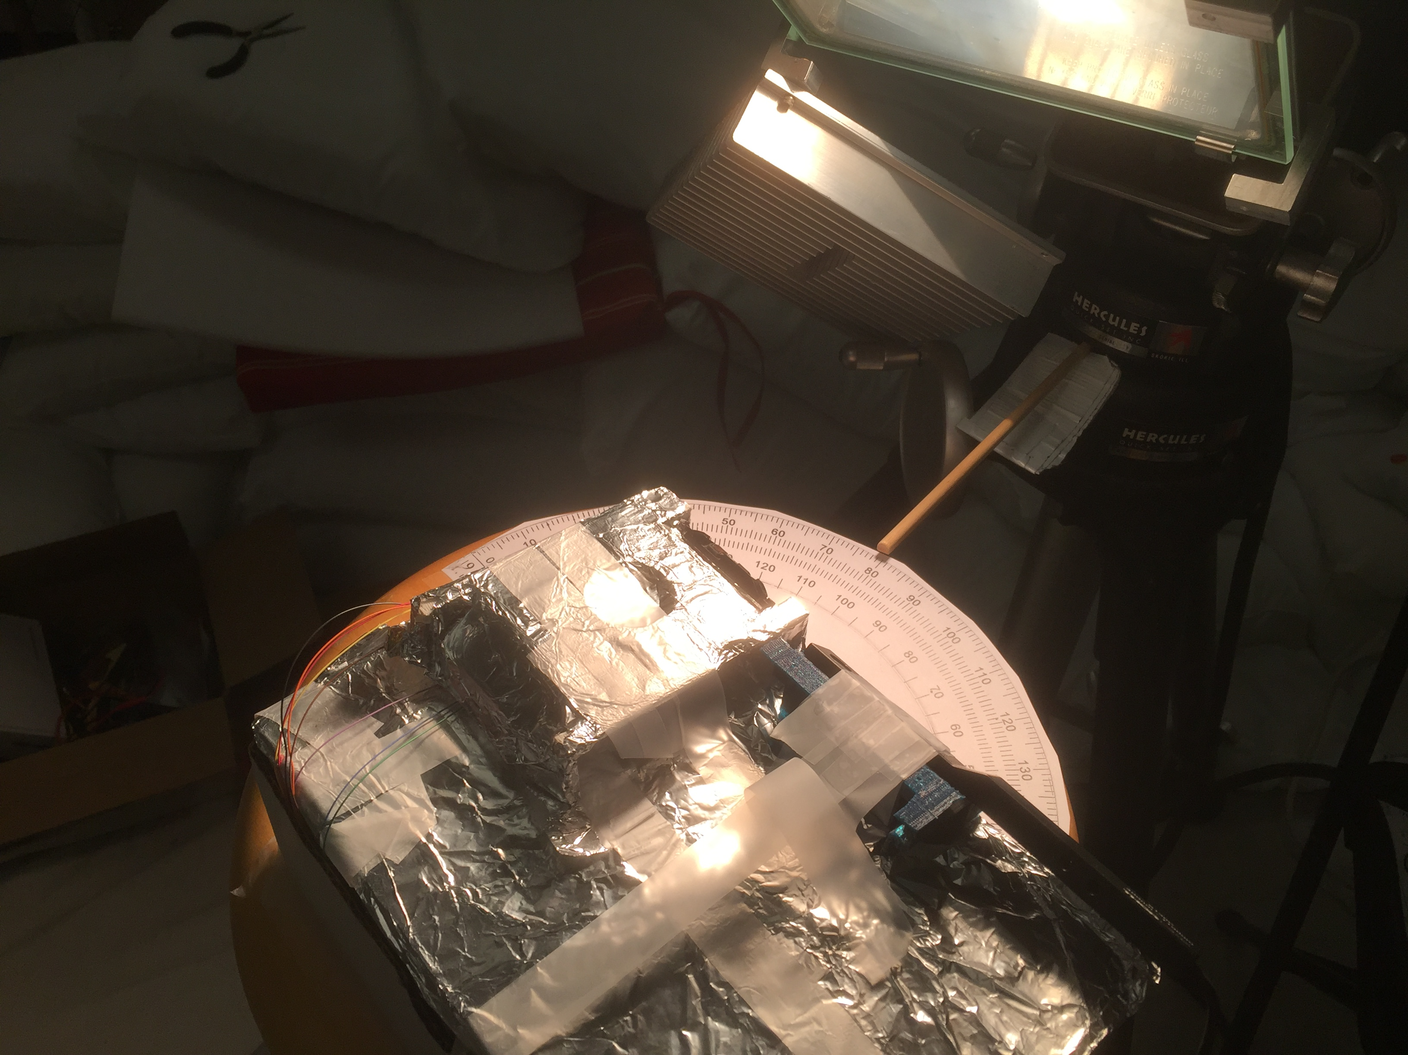
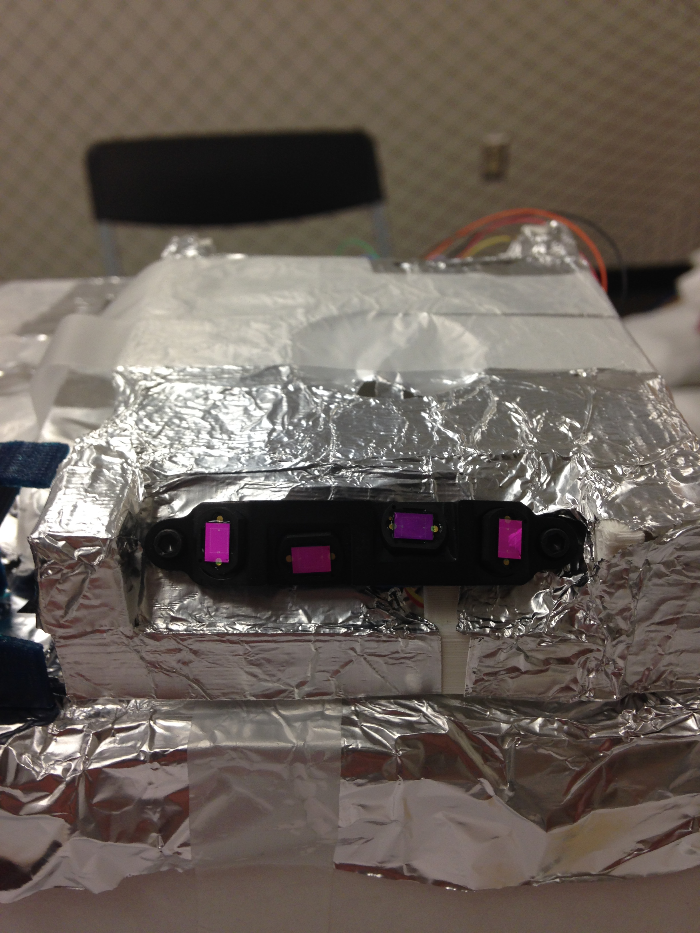
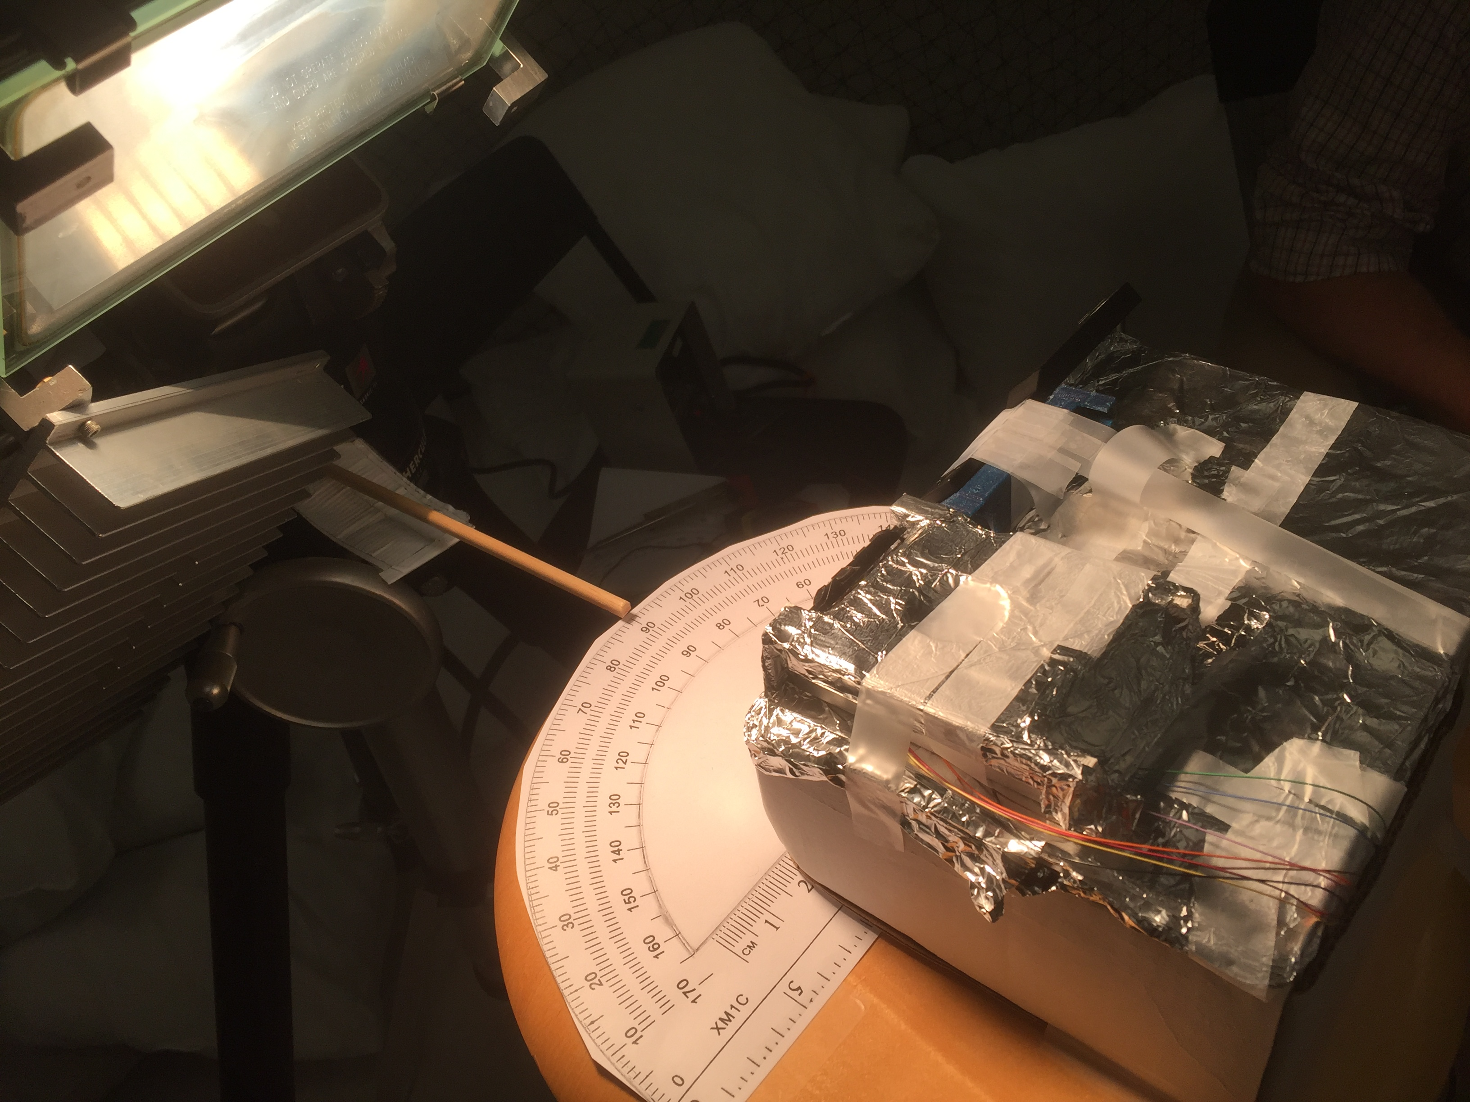
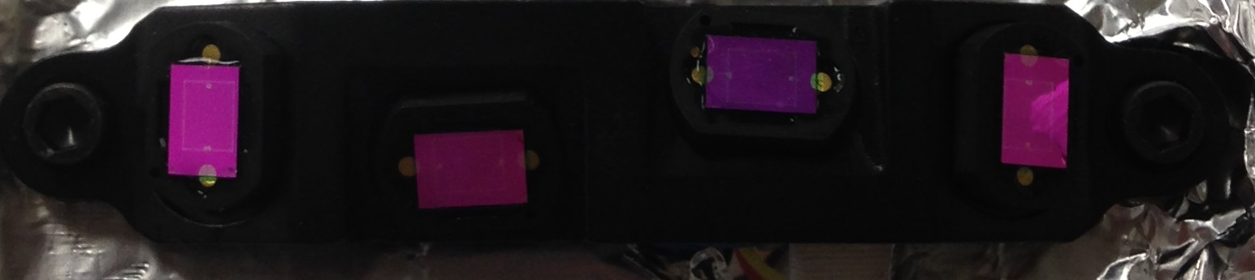
Pictures

Slide 10
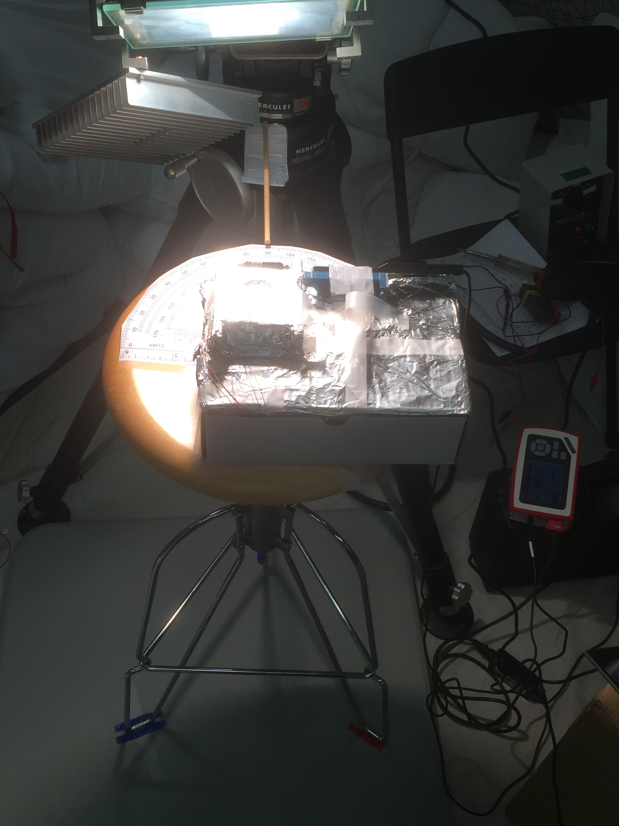
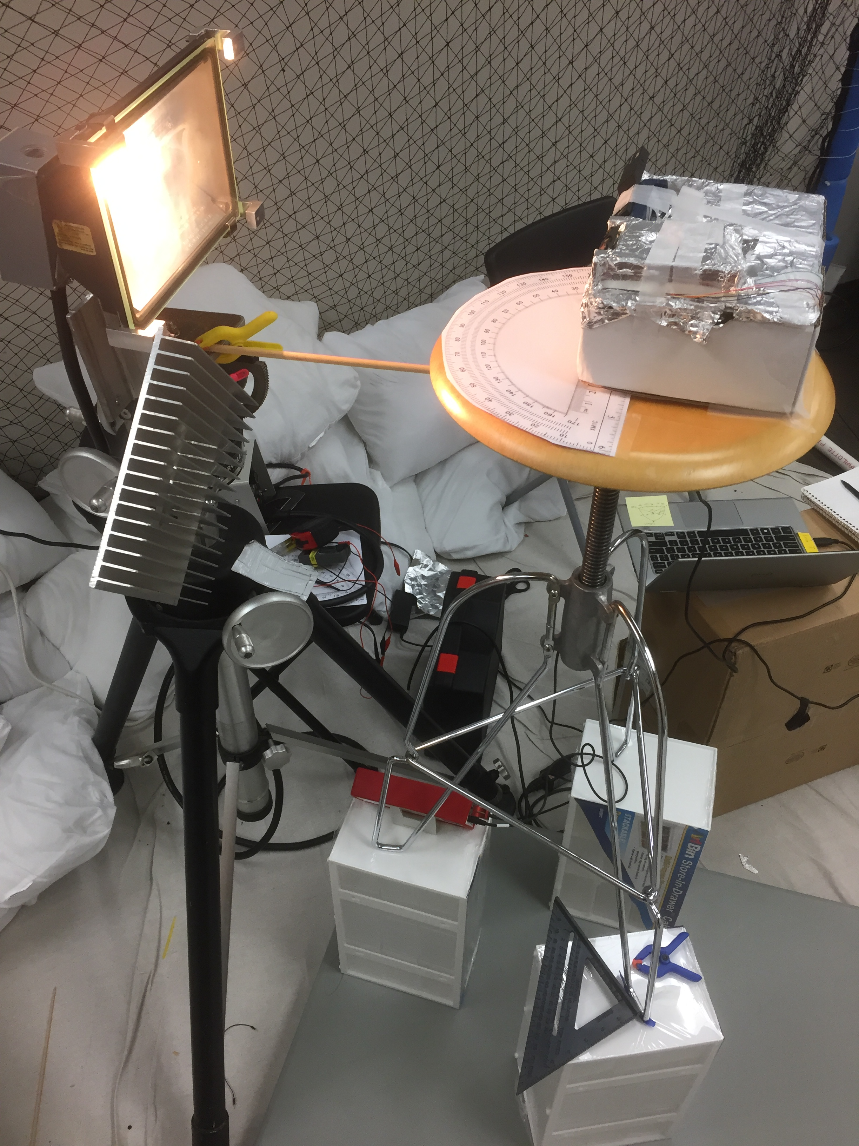
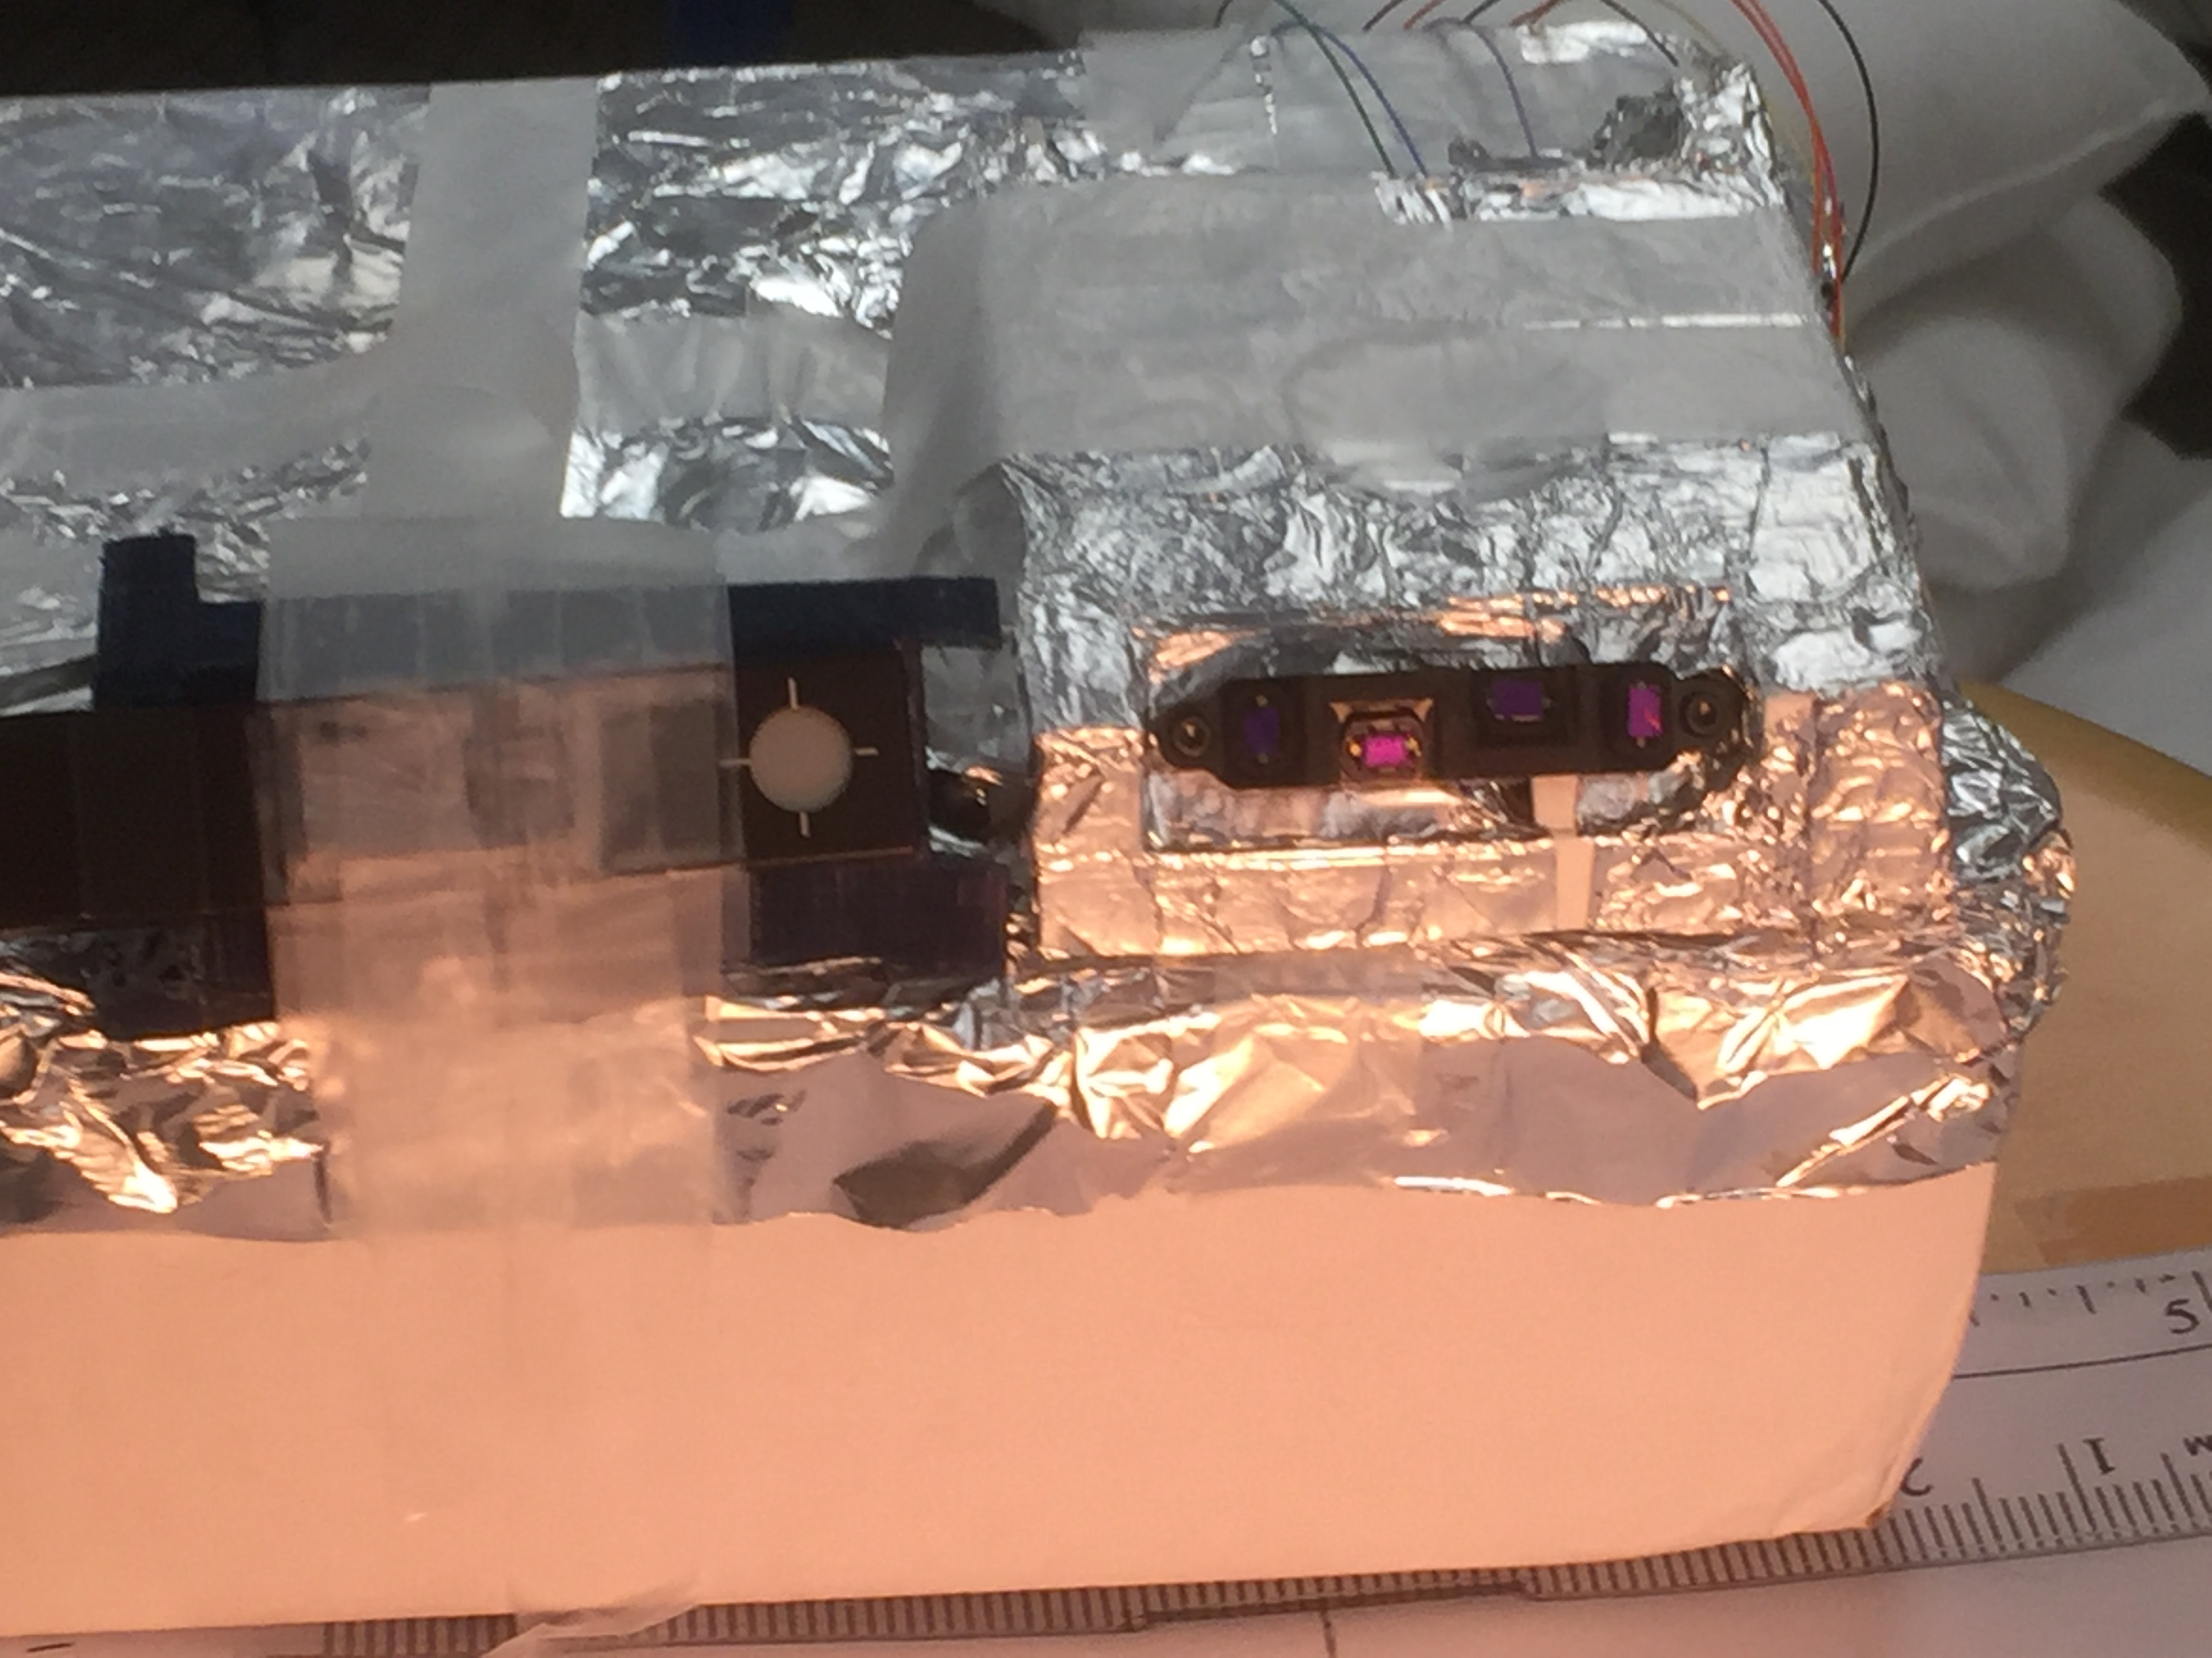
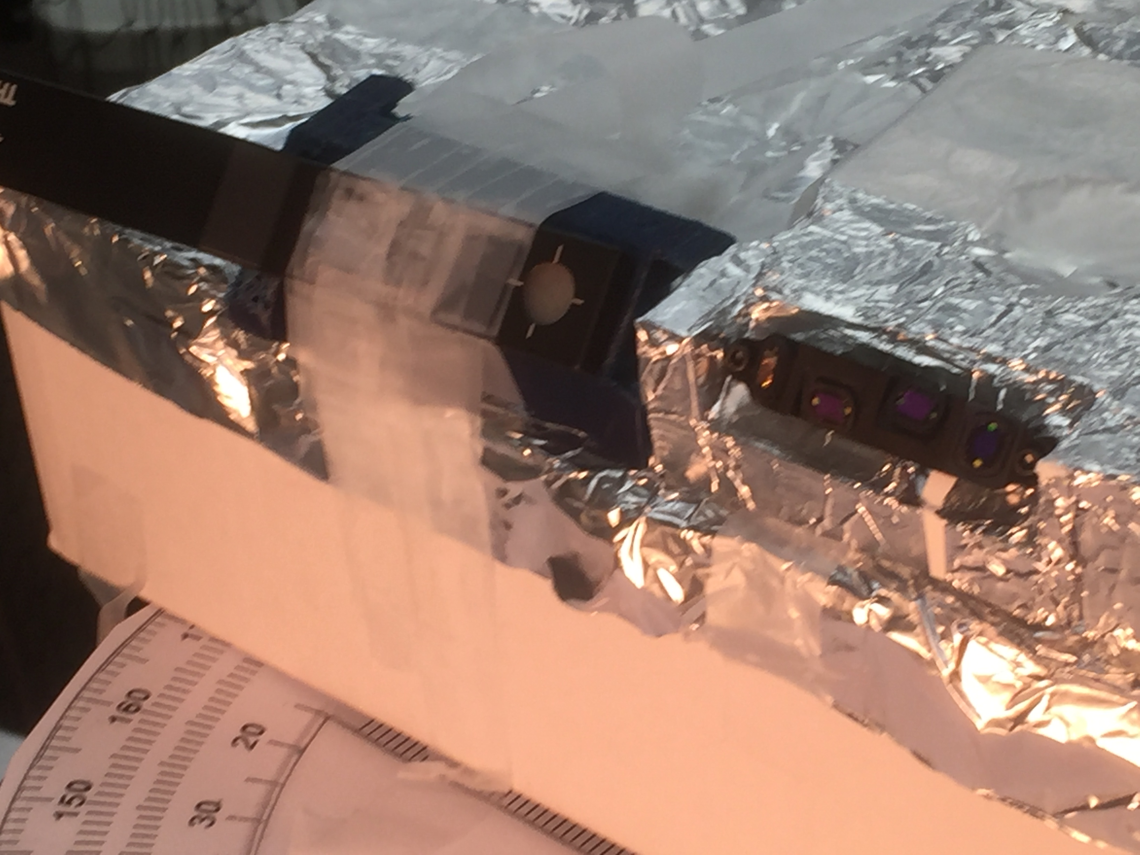
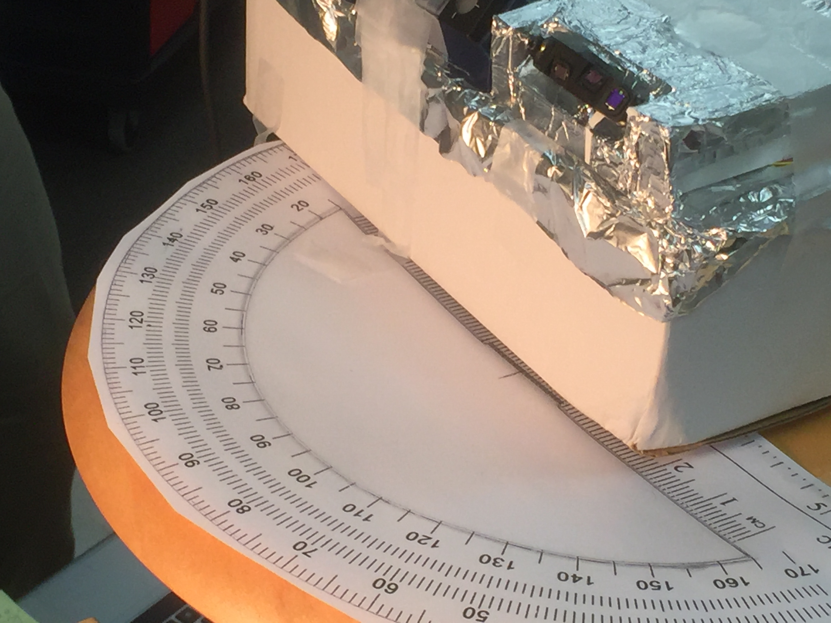
Pictures

